Slide 1
EPQ – Artefact Server Controller
By James Rand

Slide 2
The main aim of the project
File server that is used to store work
Sever cannot always be on.
I always want to have access to the server.
Build a device that can remotely turn on and off the server.

Slide 3
Checklist
Be able to turn the server on and off
Be power efficient to avoid cost
Forward a shell to the server
Have an interface to perform all of the tasks above
Do not exceed the budget of £50.00

Slide 4
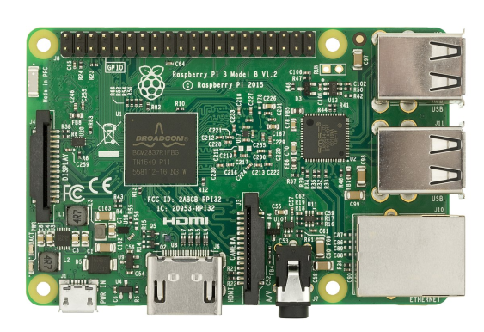
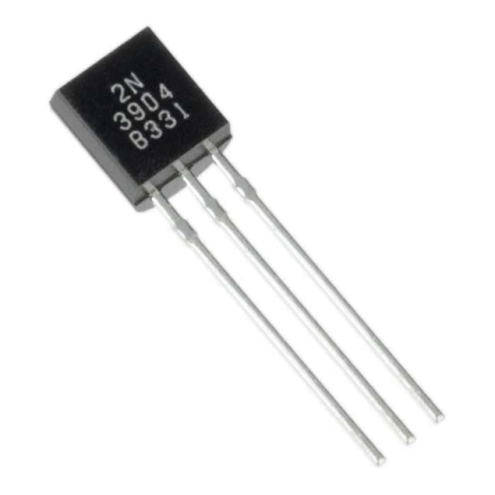
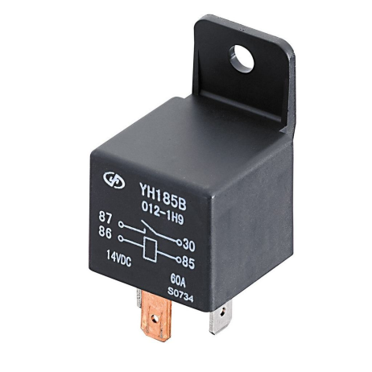
Choosing the components
Need a development board that can connect to WiFi
Raspberry pi
Photon
Electronic switches that can be controlled by the board
Relays
Transistors

Slide 5
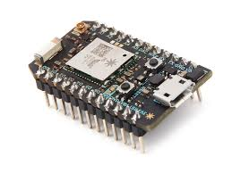
The particle photon
Pros
Relatively cheap
Has extensive api to help program
Draws little power
Good documentation
Cons
Does not have an OS to interact with
Limited functionality

Slide 6
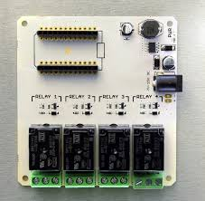
Relay board
Pros
Can handle high voltages with ease
Detachable
Easy to use
Expandable
Cons
Expensive

Slide 7
Design for turning on the server
These wires go to the
Particle photon
Relay

Slide 8
Stopping standby to save more power
Wires to controller

Slide 9
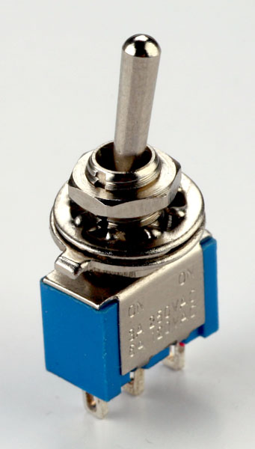
Adding a override switch
Decided to add a switch
Stops any attempts to turn
on the server

Slide 10
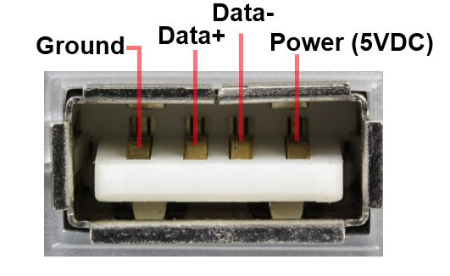
An interesting Quirk
Usb port is only powered when the server is on
Use this power to turn off the controller using another relay

Slide 11


Code
An interface in python
Code on the controller written in C
Also using the api for the controller code

Slide 12
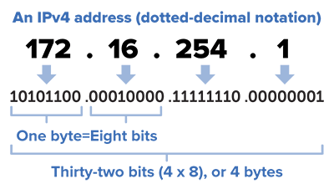
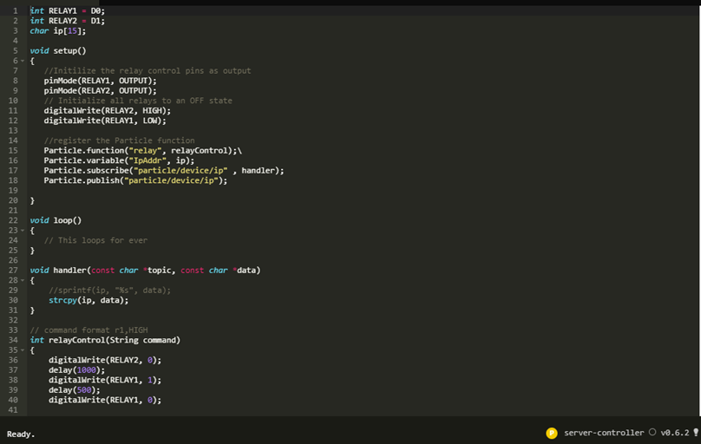
Controller code
Saves the ip address
Activates the relays

Slide 13


Python interface
Send the request to turn on the server
Get the ip address from controller
Use that ip address to open ssh connection

Slide 14

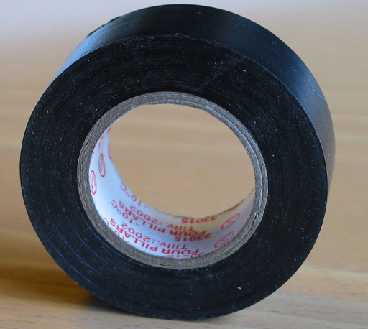
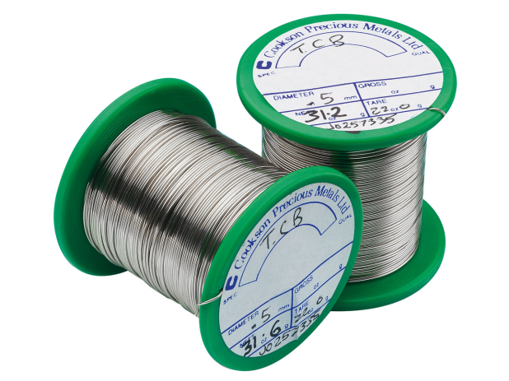
Putting it all together
Processes used
Soldering
Materials used
solder
Electrical tape

Slide 15
Evaluation
What went well
Turns on the server
Uses very little power
What went poorly
The python interface is buggy and unstable
This could be improve without time constraints
Could have ported the interface to a bot so many users could interact with it

Slide 16
What I’ve Learnt
Learnt about different electronic components and how they work

